Slide 1
Project 12: Image Ranking
Group 36: Bryan Lunt, Askar Mukhanov, Aidana Karipbayeva

Slide 2
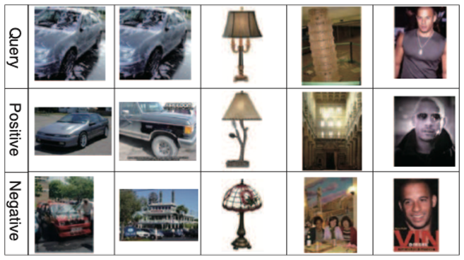
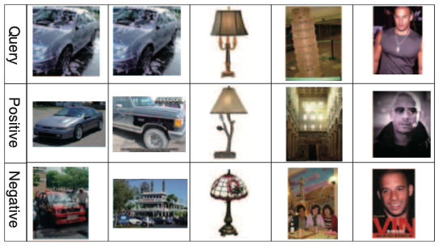
Introduction
Images are similar if they belong to the same category.
Notes:
aaa

Slide 3
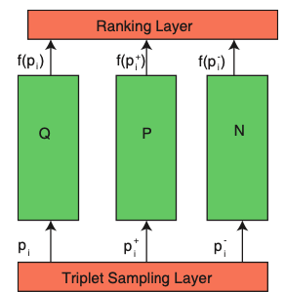
Model Architecture
Triplet Sample Layer samples a triplet - (q, p, n)
Deep Neural Network maps each image to a point in Euclidean space - f(q), f(p), f(n)
Ranking Layer evaluates a hinge-like loss of embeddings:
f(q)
q
p
n

Slide 4
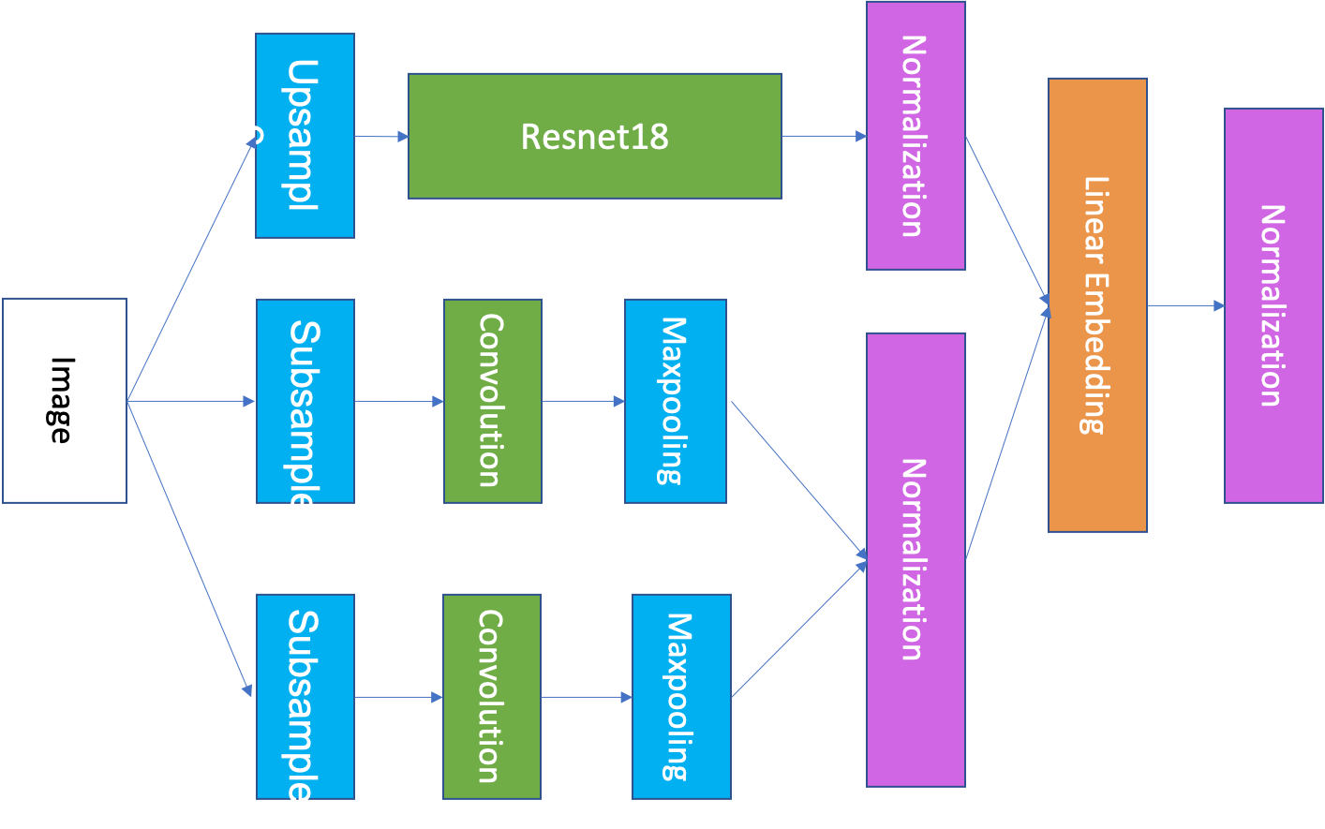
Original network with upsampling

Slide 5
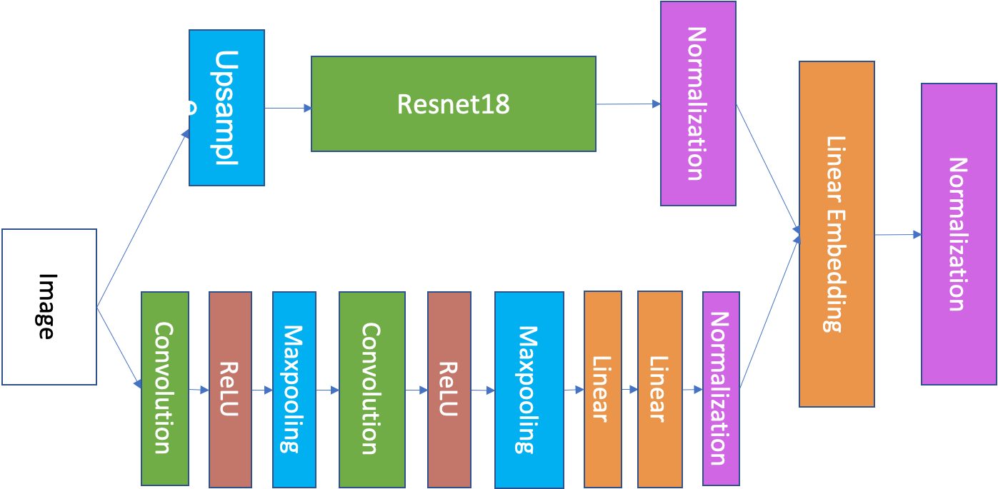
ResNet18 + one convolutional branch

Slide 6
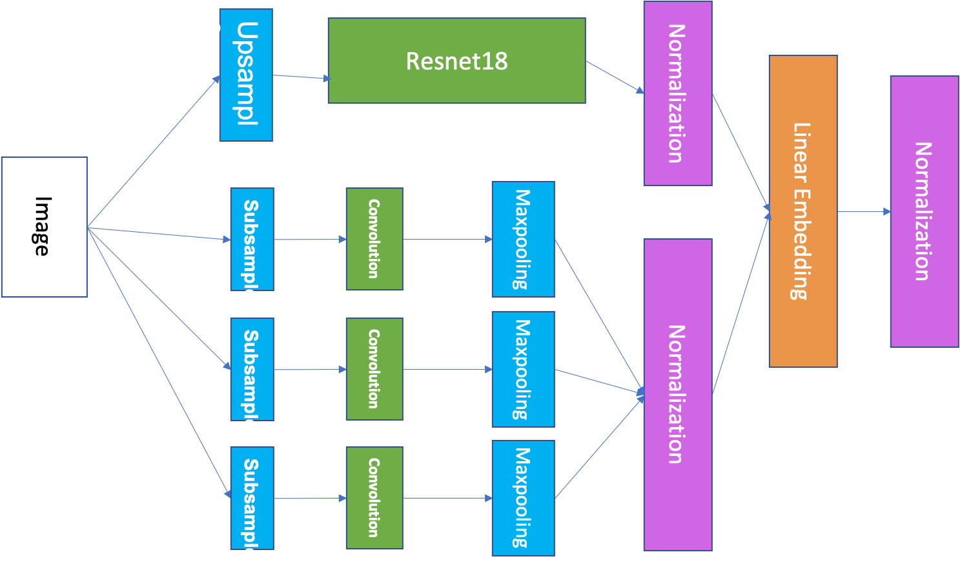
ResNet18 + three convolutional branches

Slide 7
Dataset
TinyImageNet dataset:
Size of images - 64x64
200 classes
training set: 500 images per class
validation set: 50 images per class
testing set: 50 images per class

Slide 8

Accuracy Metrics
Accuracy on triplets:
KNN-1: the nearest neighbor is from the same class as the query image
KNN-30: of 30 nearest neighbors at least one is from the same class as the query image

Slide 9
Performance Comparison
Model | Accuracy on training triplets | Accuracy on testing triplets | KNN-1 | KNN-30
ResNet18 | 95% | 86% | 18% | 40%
Original Network | 91.5% | 80.4% | 8% | 27.4%
ResNet18 + one conv branch | 93% | 80.7% | 12.1% | 29.1%
ResNet18 + three conv branches | 92.2% | 80.5% | 9.8% | 25.4%

Slide 10
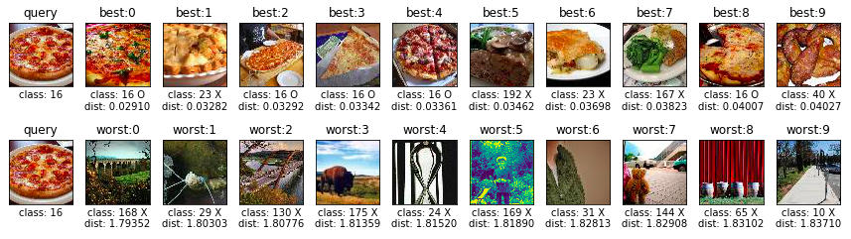
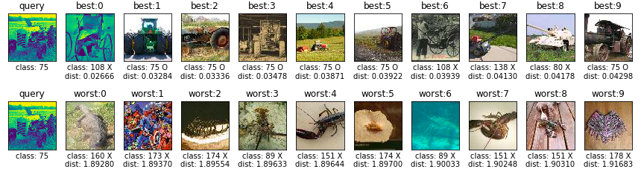
Ranked Results

Slide 11
Conclusion
Train resnet101 to capture subtle image semantics
Increase training dataset, only 500 images per class
Don’t upsample resnet input for other models.
Limit embedding vectors to the surface of a hypersphere, to the interior of a hypercube, positive orthant, etc.

